Slide 1
Self-Strengthening Movement in China
Saumya Bose
Department of History

Slide 10
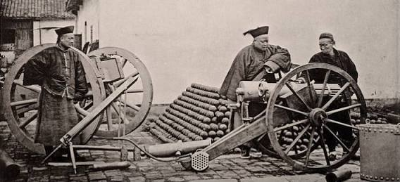

Slide 11
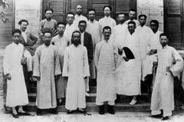

Slide 13
